Slide 1

Elastic Search
VADLANI SAI NAGESH
NAGA SUBHASH MOTURU
Dedicated to Dr. Terry Griffin

Slide 2
Demo...
Warming up our instance

Slide 3
AGENDA
Overview
History, Product overview
ES Vocabulary
Feature set
Demo
Setup/ Configuration

Slide 4
An Overview on Elasticsearch and its usage
"Creating a scalable search solution is the main purpose". So, "A solution built from the ground up to be distributed" and with a common interface, JSON over HTTP, suitable for programming languages other than Java as well.

Slide 5
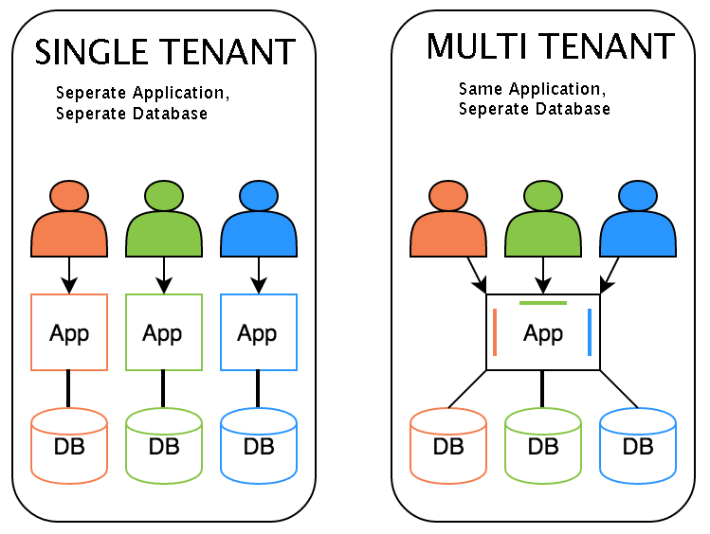
Why Elasticsearch ?
Easy to scale (Distributed)
Everything is one JSON call away (RESTful API)
Excellent Query DSL
Multi-tenancy
Support for advanced search features (Full Text)
Configurable and Extensible
Document Oriented
Schema free
Active community

Slide 6
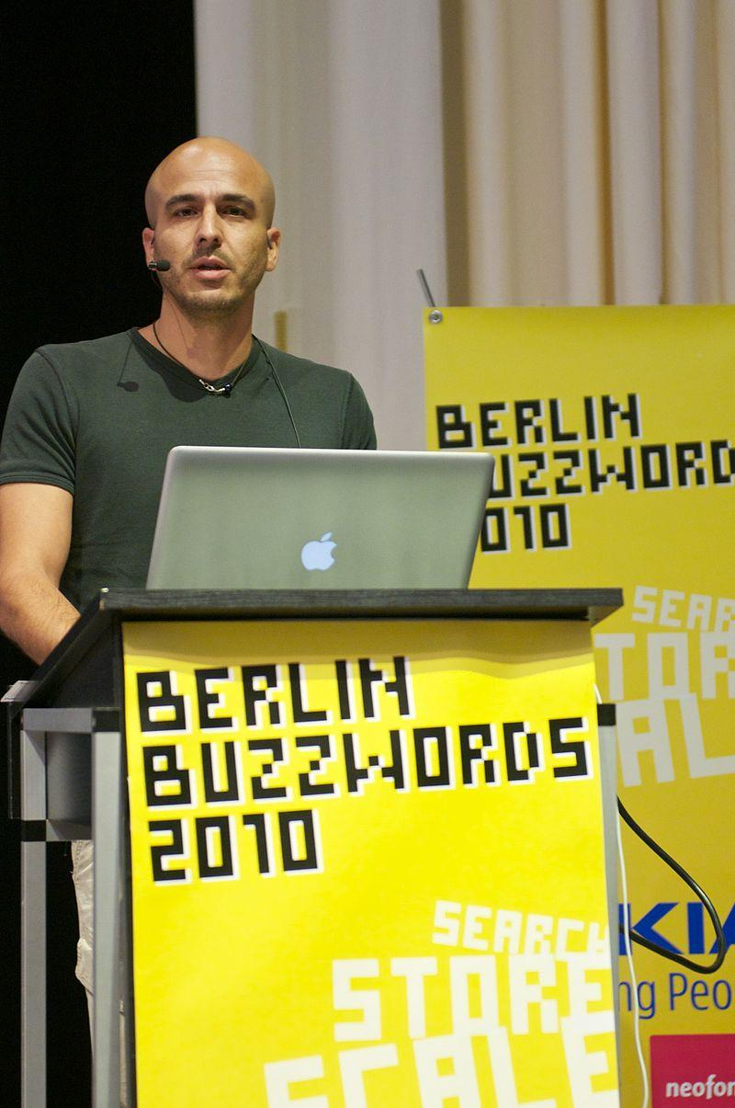
What is Elasticsearch?
ElasticSearch is a free and open source distributed inverted index created by shay banon.
Build on top of Apache Lucene
Lucene is a most popular java-based full text search index implementor.
Developed in Java, so inherently cross-platform
First public release version v0.4 in February 2010.

Slide 7
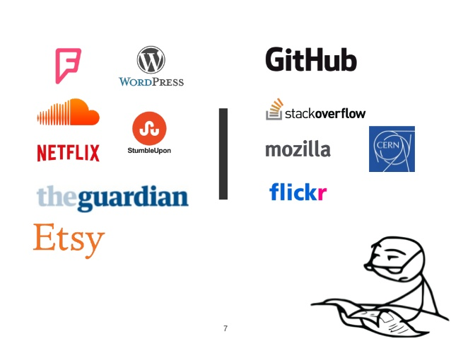

Where it is used?

Slide 8
Can Elasticsearch be compared to an RDBMS?
Elasticsearch is not meant to be a primary datastore. It is used for a simple relational database like Postgres and use simple SQL queries / a ORM mapper. If the dataset is not really large it should be fast enough.
When you have performance issues on searches you can use a combination of relation db and Elasticsearch.

Slide 9
Who is Elasticsearch main competitor ?
Elasticsearch’s main competitor as an open source search engine is Apache Solr, as it is hard to get started with because of its configuration files which are reams of XML.
Elasticsearch however has been designed so that you can start it up and start indexing data very quickly.
It has attracted a lot of users new to 'search', especially from startups. They have also pushed it as an analytic solution for Big Data, a popular subject at present.
Notes:
The eponymous company behind Elasticsearch has also received a lot of venture funding and has used some of this on marketing to the hacker community, running Meetups, hackathons and attending relevant events.

Slide 10
What is ES’s main purpose?
Elasticsearch is a database that stores, retrieves, and manages document-oriented and semi-structured data.
The relational database works comparatively slowly when it comes to huge data and fetching search results through database queries.
Understandably, businesses nowadays are looking for data storage alternatives in the hope of promoting quick retrieval.
This can be achieved by adopting NoSQL rather than RDBMS for storing data.

Slide 11
ES is very popular, what drives its popularity?
So, solr is a big powerful search engine and all the committers used it for big complex issues. Meanwhile, internet changed and lots more smaller groups wanted search engines and they wanted them to work with JSON. They also wanted it to work on a "cloud" (distributed).
Recently, LucidWorks - one of the commercial Solr-based companies recognized this issue and has put some real money into improving Solr usability and Solr onboarding process.

Slide 12
What is it written in?
Elasticsearch is a search engine based on the Lucene library. It provides a distributed, multitenant-capable full-text search engine with an HTTP web interface and schema-free JSON documents. Elasticsearch is developed in Java.
Is it memory resident?
Yes
Does it use Btree’s like databases?
Yes

Slide 13
Terms used in Elasticsearch
● node: running instance of Elasticsearch
● cluster: group of nodes with the same cluster name
● elasticsearch = relational DB
● indices = databases
● types = tables
● documents = rows

Slide 14
Terms used in Elasticsearch
● fields = columns
● index (noun) = like a database in a traditional relational database
● Index (verb) = to index a document is to store a document in an index (noun)
● Inverted index = relational databases add an index, such as a B-tree index, to specific columns in order to improve the speed of data retrieval. Elasticsearch and Lucene use a structure called an inverted index for exactly the same purpose.

Slide 15
Set up Elasticsearch
how to setup Elasticsearch and get it running, includes:
Downloading
Installing
Starting
Configuring

Slide 16
Let’s fly into Demo again……..
https://medium.com/@victorsmelopoa/an-introduction-to-elasticsearch-with-kibana-78071db3704

Slide 17

THANK YOU

